Slide 1


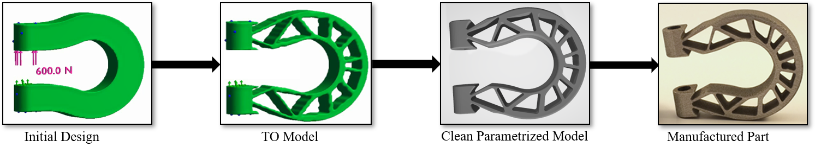
Tutorial 1
Learning Topology Optimization Through Examples and Case Studies
August 18, 2019

Slide 2
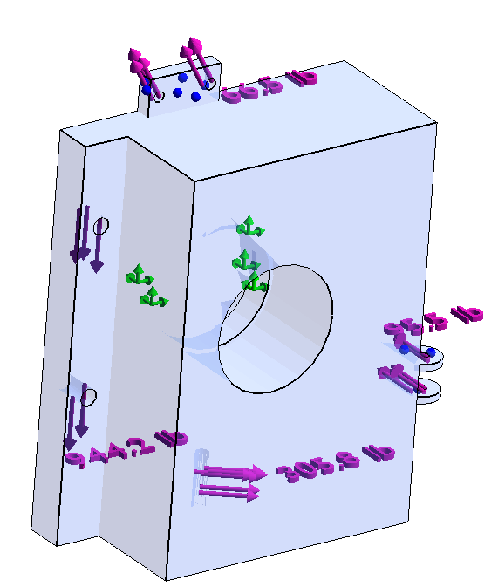
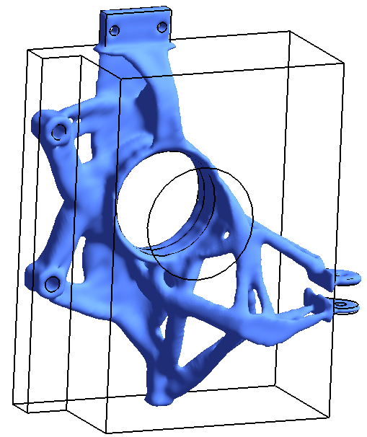
Topology Optimization Overview
Topology
Optimization
Final Topology
(93% volume reduction)
Initial Design

Slide 3
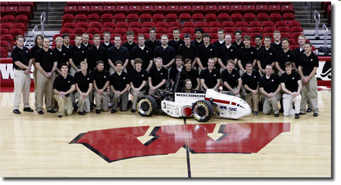
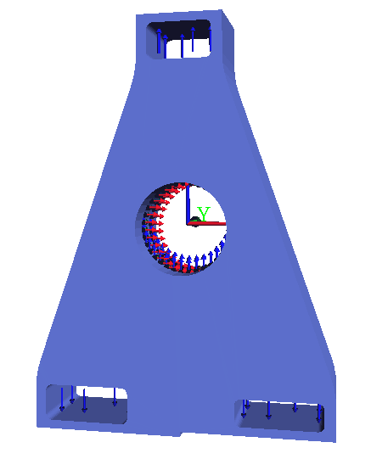
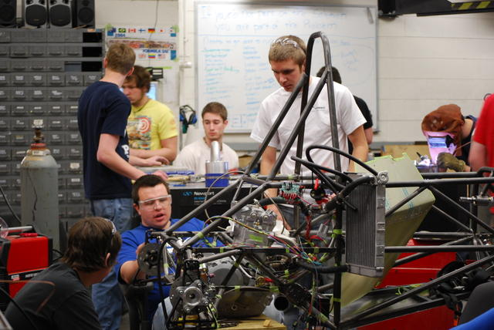
Design Problem
Minimize weight

Slide 4
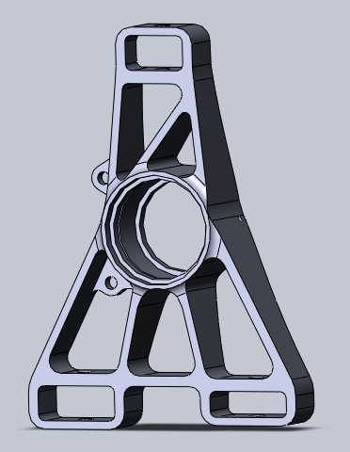
Manual Optimization
Weeks of FEA
3240 grams
734 grams
Add holes → Modify topology

Slide 5
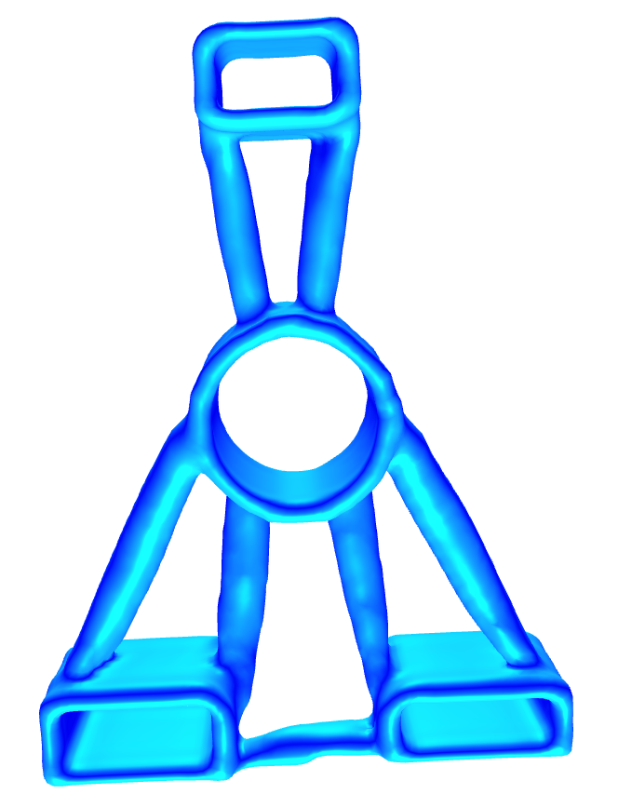
Topology Optimization
Topology
Optimization
(minutes)

Slide 6
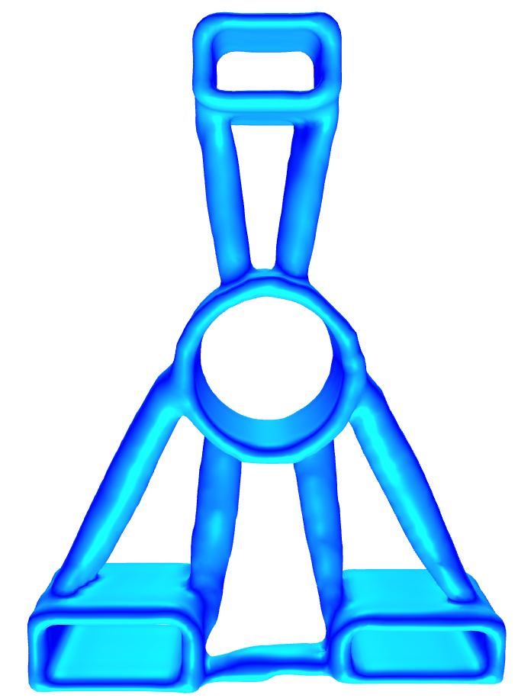
Comparison
734 grams
697 grams

Slide 7
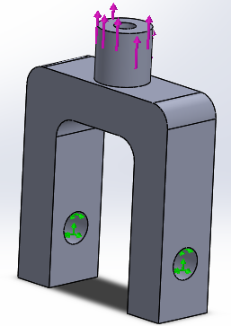
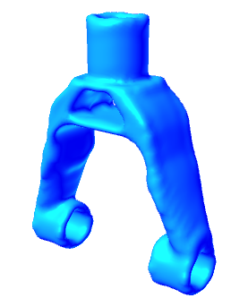
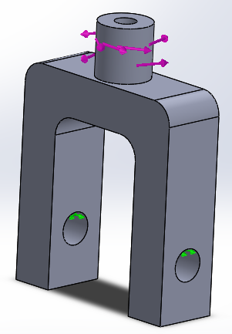
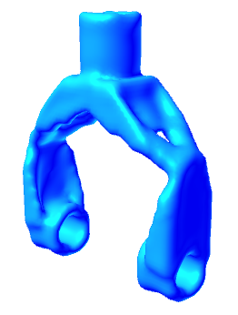
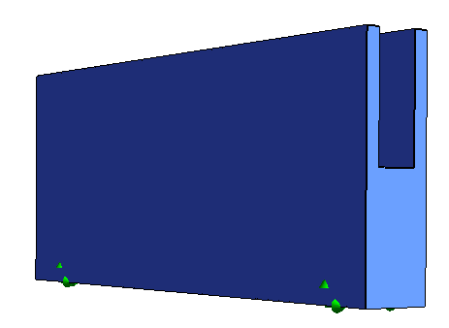
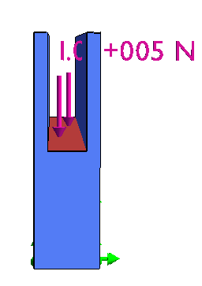
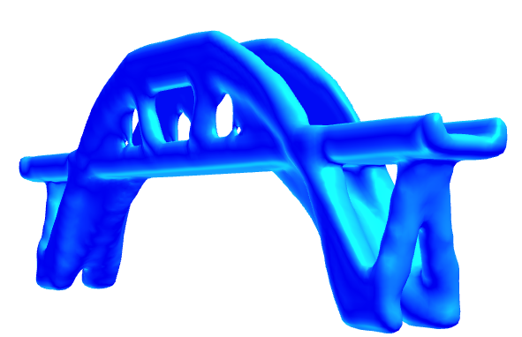
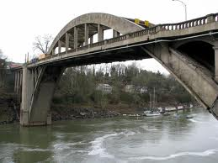
Why TopOpt?
Tensile Load
Torque Load

Slide 8
TopOpt Workflow
Design
Space
FEA
Done?
Change
Topology
No
TopOpt relies on FEA
TopOpt is computationally intensive!

Slide 9
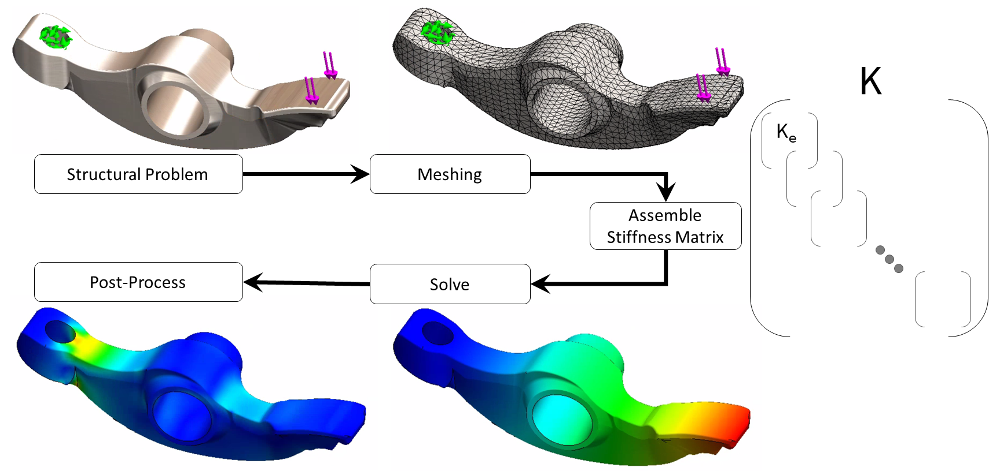
FEA

Slide 10
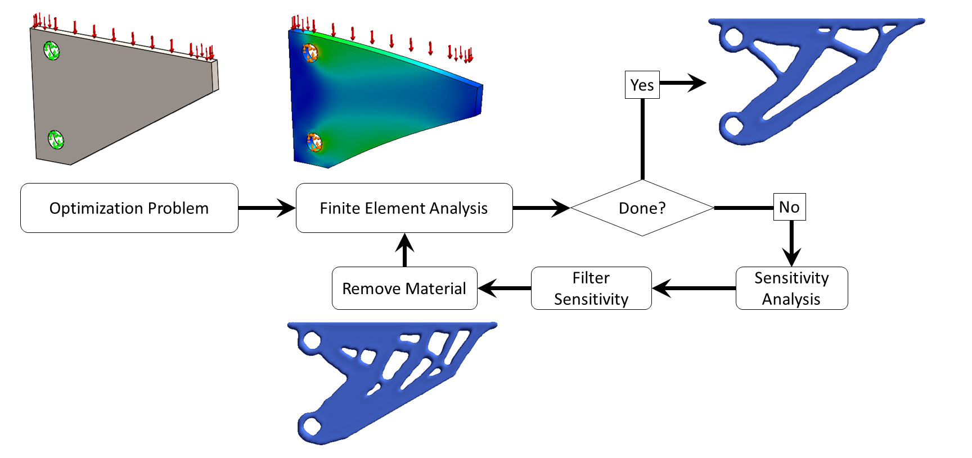
TopOpt relies on FEA

Slide 11
Current TO Strategies
TO Strategies
Homogenization
SIMP
Level-Set
Evolutionary
Pareto

Slide 12
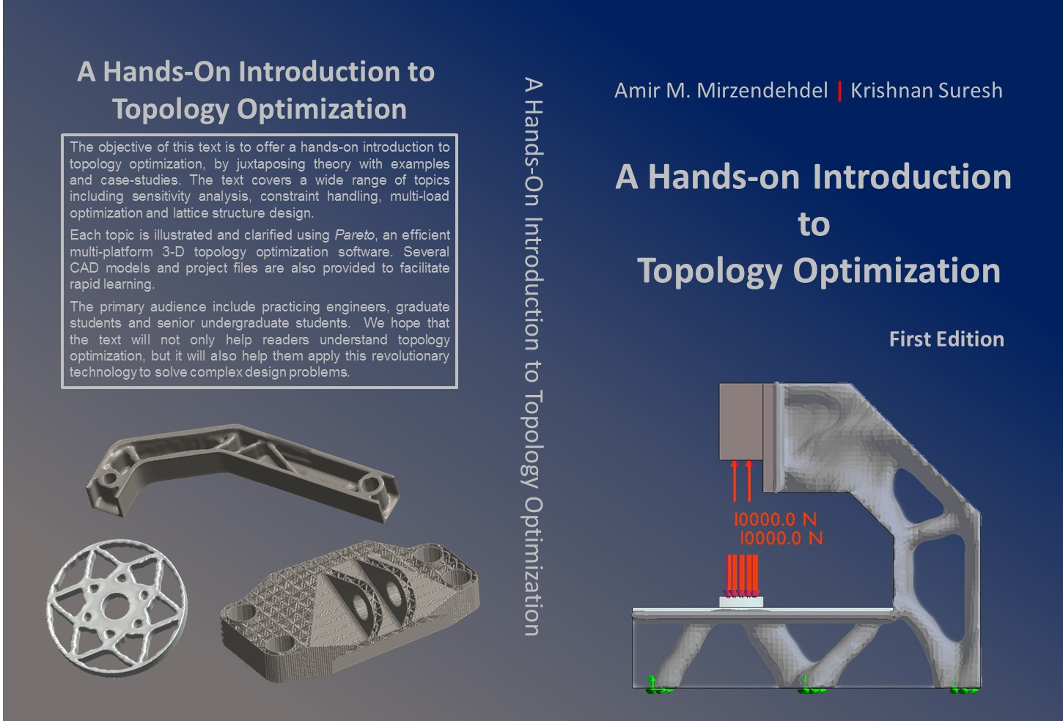

Introductory Text

Slide 13
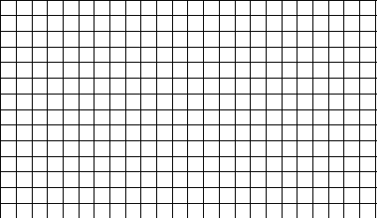

SIMP
SIMP: Solid Isotropic Material with Penalization
Where do we add holes?
Theory to be discussed later

Slide 14
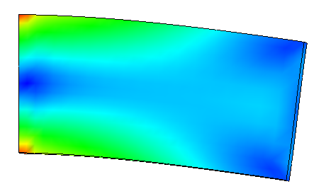
Pareto: Intuition …
Stress Plot
Remove material, but keep it stiff!
strong!
A
B

Slide 15
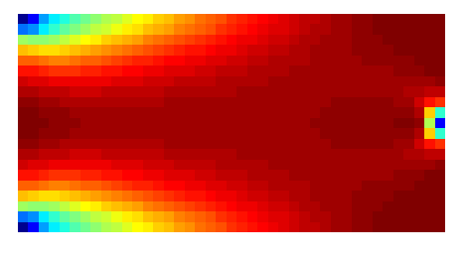
Topological Sensitivity
B
A
1.36
0.00004

Slide 16
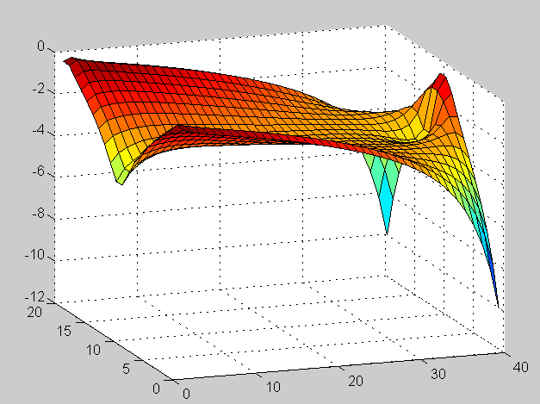
Visualize in 3-D

Slide 17
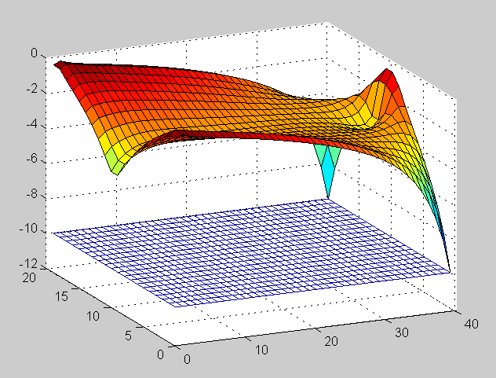

Topological Level-Set

Slide 18
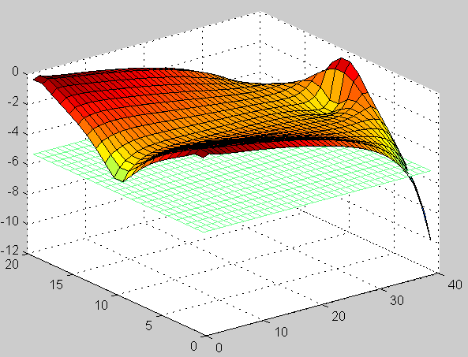
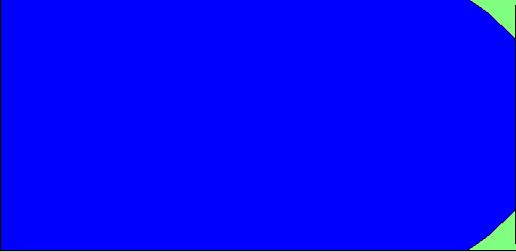
Topological Level-Set

Slide 19
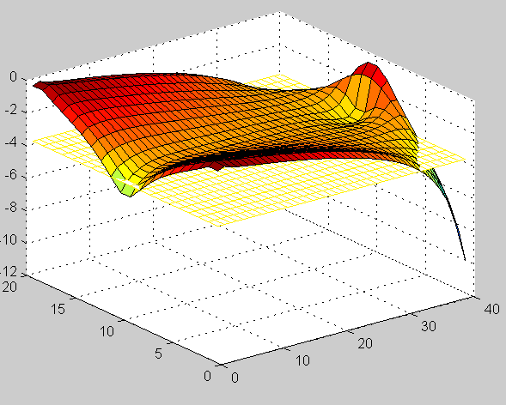
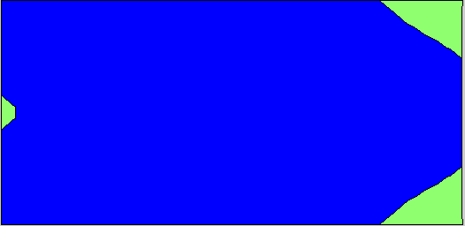
Topological Level-Set

Slide 20
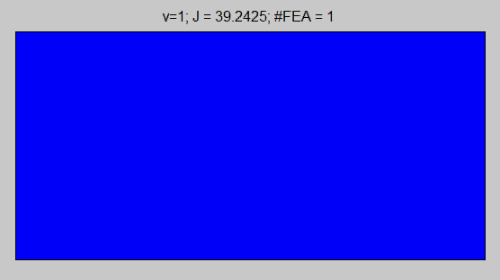
SIMP vs. Pareto
SIMP
Pareto

Slide 21
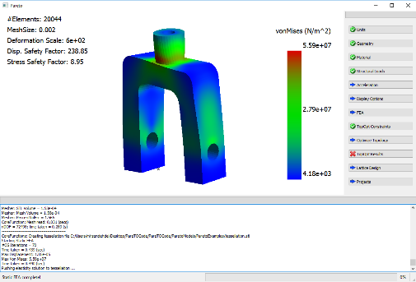
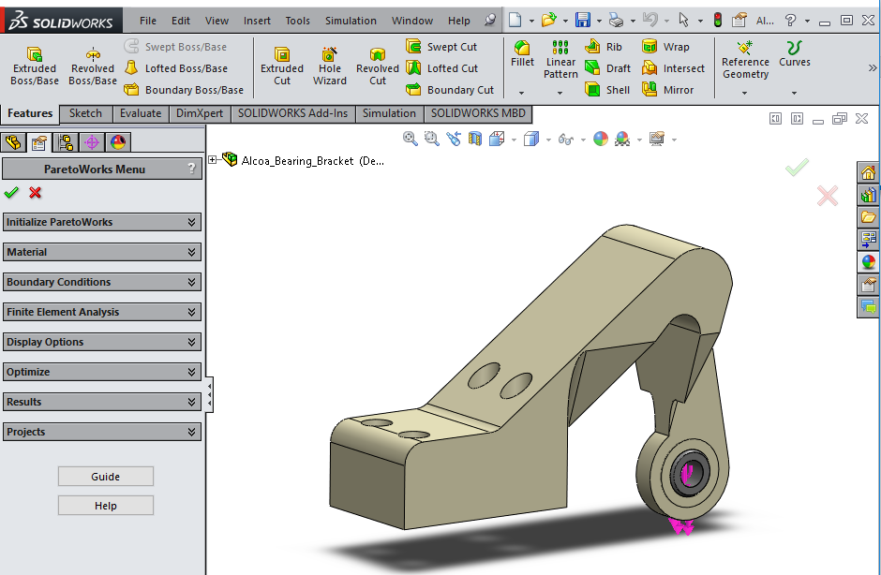
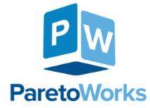
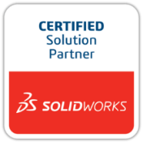

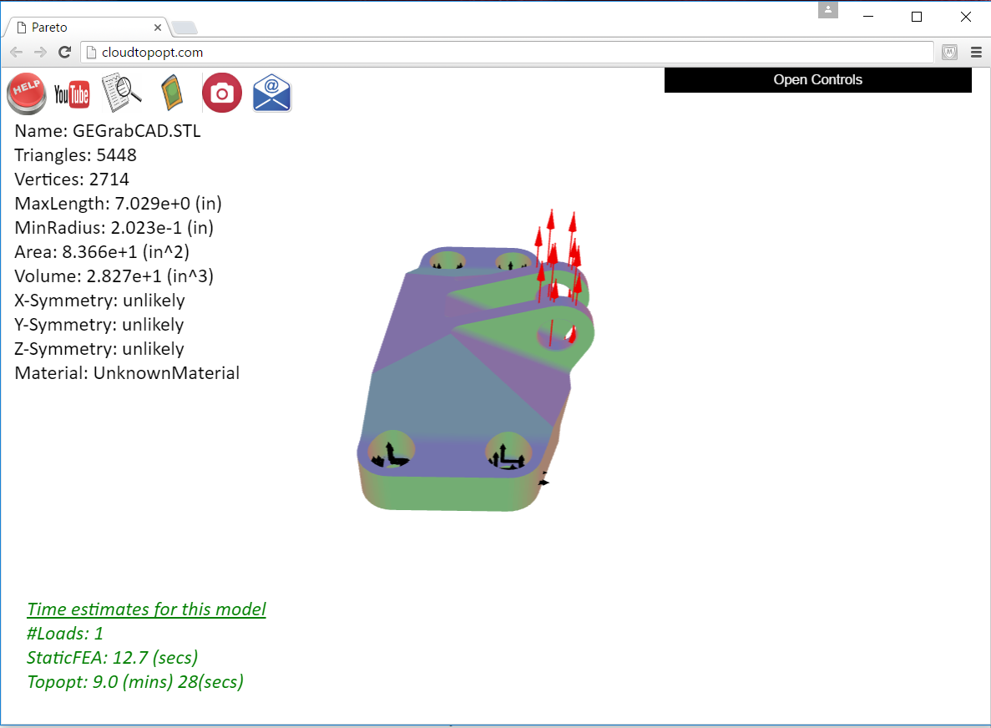
Pareto Technology
Pareto
Windows/ Mac/
Linux
SolidWorks
Cloud
…
…
Creo
ParetoWin
ParetoMac
Generative Design in
PTC Creo®
cloudtopopt.com

Slide 22
TopOpt Overview
TopOpt Capabilities?
  Myths
  Design/Manuf. constraints
  Multi-physics
  Multi-body
  Multi-material
  Lattice structure
  AM workflow
  CAD integration

Slide 23
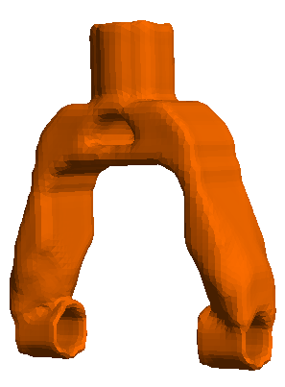
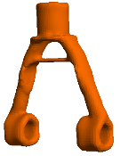
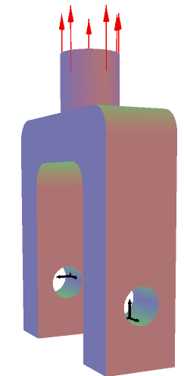
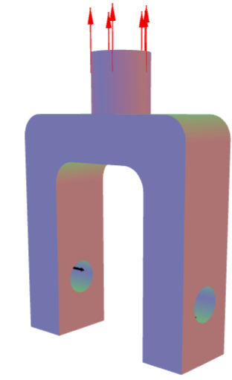
Myth 1: Must guess vol. fraction
Find stiffest topology for vol. fraction of 0.3
0.4
0.35
No
Does it meet constraints?
Decrease V_{f}
Yes
Find optimal topology!

Slide 24
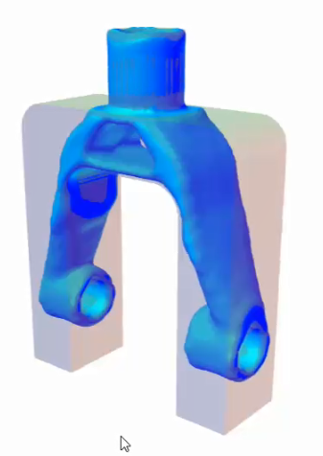
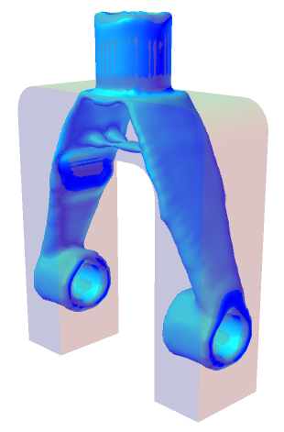
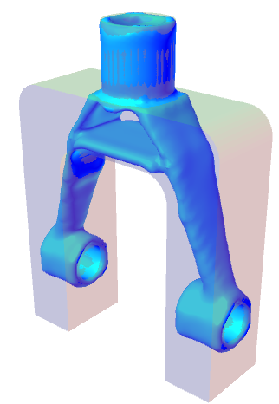
Myth 1: Must Guess Vol. Fraction
Stress < 30 ksi
V_{f} = 0.39
Desired volume: 0.01
Satisfy all constraints
Stress < 40 ksi
V_{f} = 0.31
Stress < 40 ksi
Retain surface
V_{f} = 0.38

Slide 25
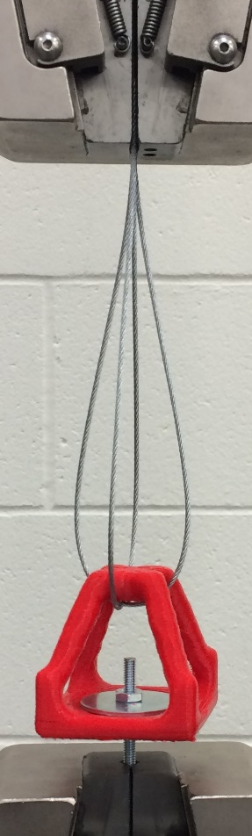
Myth 2: TopOpt Creates Stiff Designs
Stiff Design
Strong Design
[www.ersl.wisc.edu]
Notes:
Talk through your results – what stood out? What surprised you?

Slide 26
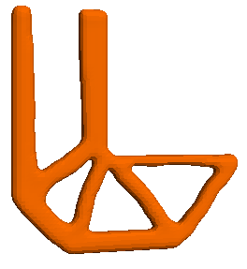
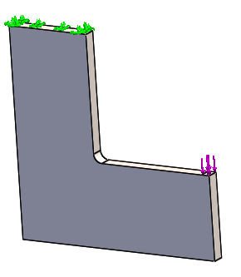
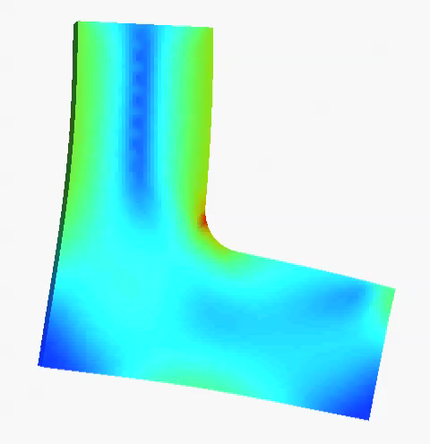
Stiff vs. Strong
Stiff Design
Strong Design
Suresh, K., Takalloozadeh, M., “Stress-constrained topology optimization: a topological level-set approach”, Structural and Multidisciplinary Optimization, Vol. 48, Issue 2, pp. 295-309, 2013

Slide 27
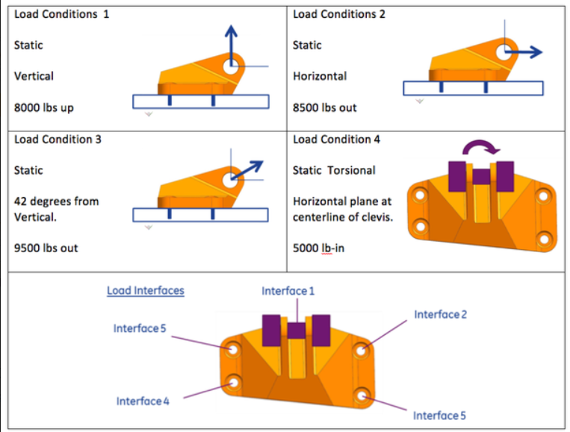
Myth 3: TopOpt is Slow
GE Design Contest
(2013)
https://grabcad.com/challenges/ge-jet-engine-bracket-challenge

Slide 28
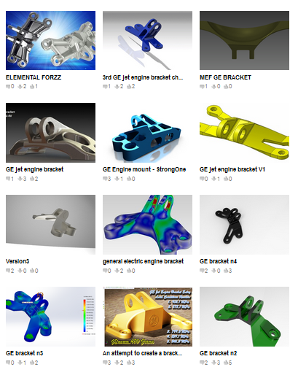
Myth 3: TopOpt is Slow!
640 entries
“After designing more than 20 models finally we give our best design with 72% mass reduction”
Trial & error
“We (Elemental Design Team) are awaiting for your feedbacks.”
Team effort
“ There are still about 35 days left in the contest, so I think you'll see the more creative solutions”
Time consuming

Slide 29
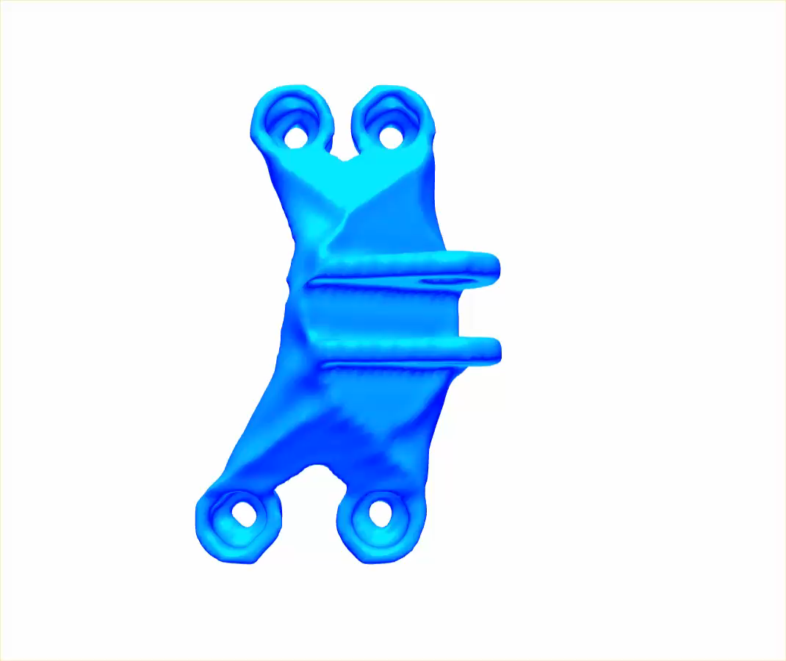
Myth 3: TopOpt is Slow!
No trial & error
Single person
300K elements
76% reduction
15 mins (laptop)

Slide 30
TopOpt Overview
TopOpt Capabilities?
  Myths
  Design/Manuf. constraints
  Multi-physics
  Multi-body
  Multi-material
  Lattice structure
  AM workflow
  CAD integration

Slide 31
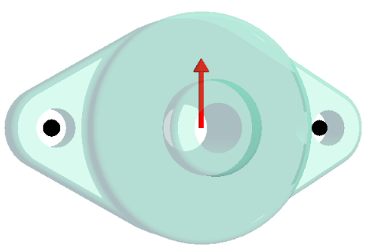
Multi-Constrained TopOpt
Stiffness
Strength
Buckling
Eigen-mode

Slide 32






Constrained TO
Compliance
Dominated
Stress
Dominated
Eigen-value
Dominated

Slide 33



Casting Constraint
No manuf. constraint
Casting constraint

Slide 34



Machine Accessibility
No Manuf. Constraint
Accessibility Constraint

Slide 35



Through Cut
No Manuf. Constraint
Through-cut

Slide 36



Non-Design Surfaces
Non-design surfaces

Slide 37








Cyclic Symmetry
No symmetry: ugly!!
3-lobe
4-lobe
5-lobe
6-lobe
7-lobe
8-lobe

Slide 38
TopOpt Overview
TopOpt Capabilities?
  Myths
  Design/Manuf. constraints
  Multi-physics
  Multi-body
  Multi-material
  Lattice structure
  AM workflow
  CAD integration

Slide 39

Multi-Physics
Pure Elastic
Thermo-Elastic
DT = 10

Slide 40



Multi-Physics
Structural & Thermal
+ Buckling Constraint

Slide 41
TopOpt Overview
TopOpt Capabilities?
  Myths
  Design/Manuf. constraints
  Multi-physics
  Multi-body
  Multi-material
  Lattice structure
  AM workflow
  CAD integration

Slide 42



Multi Body Optimization
Optimize

Slide 43
TopOpt Overview
TopOpt Capabilities?
  Myths
  Design/Manuf. constraints
  Multi-physics
  Multi-body
  Multi-material (AM)
  Lattice structure (AM)
  Support structures (AM)
  CAD integration

Slide 44



TopOpt & Additive Manufacturing
[EWI, Buffalo]
Perfect match?
Creates complex shape
Fabricates any shape
Minimizes material usage
Must reduce material!
Cool!
…
Cool!
…

Slide 45



Multi-Material
Multi-Material Topology Optimization (MMTO)
Optimize
Why?
Topology & Material Distribution
Multi-functional
Better performance
Reduced cost

Slide 46


Results
Copper-Aluminum Design is 19% stiffer than Copper Design!
[www.ersl.wisc.edu]
Notes:
Talk through your results – what stood out? What surprised you?

Slide 47

Bracket Design
[www.ersl.wisc.edu]
Notes:
Talk through your results – what stood out? What surprised you?

Slide 48
TopOpt Overview
TopOpt Capabilities?
  Myths
  Design/Manuf. constraints
  Multi-physics
  Multi-body
  Multi-material (AM)
  Lattice structure (AM)
  Support structures (AM)
  CAD integration

Slide 49


Lattice Structure
100,000 lattice unit cells ~ 2 mins
Variety of lattice choices

Slide 50

Lattice Structure
Custom-designed
microstructures

Slide 51
TopOpt Overview
TopOpt Capabilities?
  Myths
  Design/Manuf. constraints
  Multi-physics
  Multi-body
  Multi-material (AM)
  Lattice structure (AM)
  Support structures (AM)
  CAD integration

Slide 52


Support Structures
Needed to avoid ‘drooping’ and ‘burning’
Increase fabrication, material & clean up cost
Process dependent
[EWI, Buffalo]
https://innovationstation.utexas.edu/tip-design
Mertens R, Clijsters S, Kempen K, Kruth J. Optimization of Scan Strategies in Selective Laser Melting of Aluminum Parts With Downfacing Areas. ASME. J. Manuf. Sci. Eng. 2014;136(6):061012-061012-7. doi:10.1115/1.4028620.

Slide 53


Minimize Support Structures
Optimize the topology to also minimize support structures
Classic Optimization
With Support Structure Constraints
[www.ersl.wisc.edu]

Slide 54

Support Constraint
50% reduction in support
23% increase in compliance
[www.ersl.wisc.edu]

Slide 55
TopOpt Overview
TopOpt Capabilities?
  Myths
  Design/Manuf. constraints
  Multi-physics
  Multi-body
  Multi-material (AM)
  Lattice structure (AM)
  Support structures (AM)
  CAD integration

Slide 56
CAD-ification

Slide 57

Towards CAD-ification

Slide 58


Summary
Plenty of Opportunities!

